Slide 1
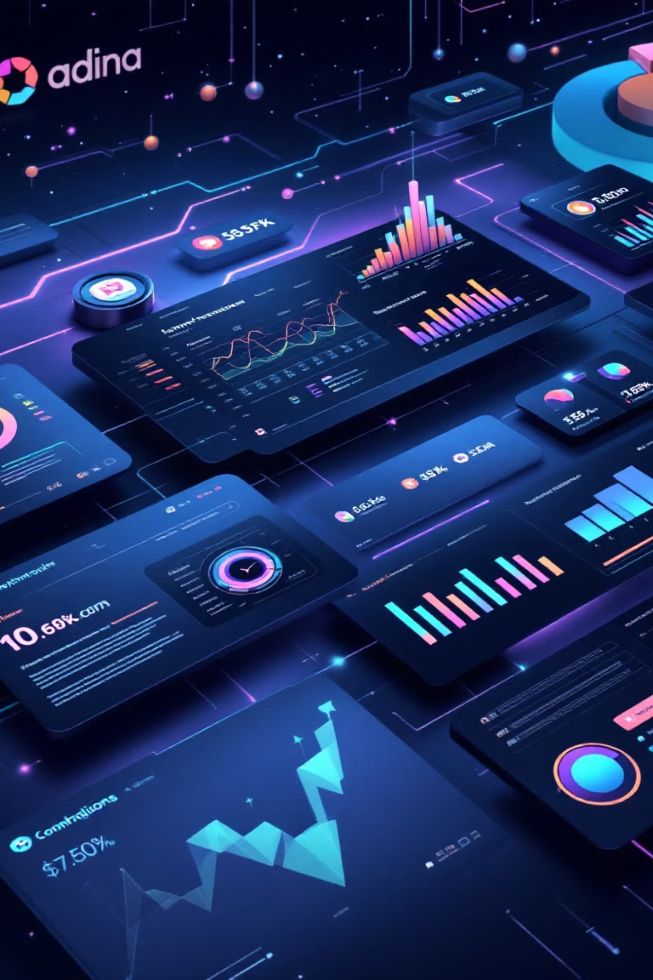
VETRI CIX
AI-Powered System for Automated Company Data Discovery & Analysis
Team Name: Quantum_core_Gen'X
Presented by: Piruthvin M | Yogendthira VK | Dinesh Suriya

Slide 2
Existing Challenges in Company Data
Scattered Data
Manual Research
Company information is fragmented across numerous websites.
Time-consuming, error-prone, and not scalable for large datasets.
Extraction Difficulty
Privacy & Cost
Hard to pinpoint key people, tech stacks, and company relationships.
Cloud-only AI models pose privacy concerns and high operational costs.
We need an automated, scalable, private, and cost-effective intelligence system.

Slide 3


VETRI CIX: The Solution
Automated Discovery
Hybrid AI Strategy
Scrapes, analyzes, and structures company data automatically.
Prioritizes local LLMs for privacy and cost, with cloud fallback.
Comprehensive Analysis
Offers single company analysis, bulk CSV processing, and visual analytics.
Result: Fast, accurate, and intelligent company insights.

Slide 4

High-Level Architecture
Scraping + LLM Engine
Frontend (React)
FastAPI Backend
Key Design Principles:
Modular services
Async processing
LLM fallback strategy
Caching for performance

Slide 5

Technology Stack
Frontend
Database
React 19
MongoDB
Tailwind CSS
AI & Automation
Recharts
AirLLM( Phi-3 mini or Qwen2.5 7-b)
Backend
Python
Ollama (mistral:latest)
FastAPI

Slide 6


Hybrid LLM Architecture
Primary (Local)
Secondary (Local Backup)
AirLLM – phi-3-mini: Free, private, fast processing.
Ollama – mistral:latest: Reliable fallback for local operations.
Benefits:
Enhanced Privacy
Optimized Cost Control
Increased Reliability
Improved Scalability
Enhanced Security
Offline Operation
Reduced Latency
Greater Customization

Slide 7
Modular Backend Services
scraper.py
extractor.py
Website scraping using Selenium + Requests.
Prepares and processes raw data for AI.
llm_service.py
search_service.py
AI extraction engine for intelligent data parsing.
Integrates DuckDuckGo for efficient search.
batch_processor.py
graph_builder.py
Handles bulk CSV/Excel data processing.
Constructs company relationship graphs.
Fully modular and reusable architecture ensures flexibility.

Slide 8

Frontend Features: Modern UI/UX
Key Pages:
UI Highlights:
Dashboard
Dark Mode & Glassmorphism
Analyze Company
Interactive Graphs & Charts
Batch Upload
Real-time Data Visualization
Analytics & Reports
CSV & Excel Upload/Download
Library
Modern, responsive, and user-friendly design for optimal experience.

Slide 9
End-to-End Data Flow
01
02
03
User Input
Scraping & Caching
LLM Extraction
URL or CSV upload initiates the process.
Backend searches, scrapes, and caches HTML for performance.
AI extracts structured JSON data.
04
05
Validation & Storage
Visualization
Data validated with Pydantic, then stored in MongoDB.
Data sent to frontend, visualized as charts and graphs.
Optimized for speed and accuracy, transforming raw data into insights.

Slide 10

Impact & Future Growth
Key Benefits:
Future Enhancements:
Automated company intelligence
Real-time monitoring
Private AI processing
Competitor comparison
Scalable batch analysis
Risk scoring
Rich visual analytics
CRM integration
VETRI CIX transforms raw web data into actionable company intelligence using AI.

